Slide 1
Chapter 15
How to work with tag helpers, partial views, and view components

Slide 2
Objectives (part 1)
Applied
Reduce code duplication in the views of a web app by creating custom tag helpers, partial views, and view components.
Knowledge
Distinguish between tag helper attributes and elements.
Explain how to register tag helpers.
Explain how to create custom tag helpers for standard and non-standard HTML elements.
Describe the use of the HtmlTarget attribute to control the scope of a tag helper.
Describe the use of the TagHelperOutput class and the TagBuilder class to add an HTML element before or after the tag helper element.

Slide 3
Objectives (part 2)
Describe the use of properties within a tag helper class.
Describe the use of dependency injection with a tag helper.
Describe the use of the SuppressOutput() method of the TagHelperOutput class to create tag helpers that send an element to the browser only under certain conditions.
Describe the use of the GetPathByAction() method of the LinkGenerator class to generate a route-based URL.
Describe what a partial view typically contains.
List and describe the paths that MVC searches for a partial view.
Describe how to use the partial tag helper to include a partial view and pass a model to it.
Distinguish between a partial view and a view component.
Describe how a view component works and how data can be passed to it.

Slide 4
Common built-in tag helpers
asp-action
asp-controller
asp-area
asp-for
asp-validation-summary
asp-validation-for
environment
partial

Slide 5
A tag helper that generates attributes for an <input> tag
<input asp-for="FirstName" class="form-control" />
The HTML that’s sent to the browser
<input class="form-control" type="text" data-val="true" data-val-maxlength="The field FirstName must be a string or array type with a maximum length of &#x27;200&#x27;." data-val-maxlength-max="200" data-val-required="Please enter a first name." id="FirstName" maxlength="200" name="FirstName" value="" />

Slide 6
A tag helper that generates a route-based URL in a <form> tag
<form asp-action="Edit" method="post"></form>
The HTML that’s sent to the browser
<form action="/Home/Edit" method="post"></form>

Slide 7
Tag helpers that output a different CSS link based on hosting environment
<environment include="Development">
<link rel="stylesheet"
href="~/lib/bootstrap/css/bootstrap.css" />
</environment>
<environment exclude="Development">
<link rel="stylesheet"
href="~/lib/bootstrap/css/bootstrap.min.css" />
</environment>

Slide 8
A _ViewImports.cshtml file that registers all built-in and custom tag helpers
...
@addTagHelper *, Microsoft.AspNetCore.Mvc.TagHelpers
@addTagHelper *, Bookstore

Slide 9
Razor code that uses HTML helpers (old way)
@{ Html.BeginForm("Edit", "Home", FormMethod.Post,
new { @class = "form-inline" }); }
@Html.LabelFor(m => m.Title)
@Html.TextBoxFor(m => m.Title,
new { @class = "form-control m-2" })
@Html.LabelFor(m => m.Price)
@Html.TextBoxFor(m => m.Price,
new { @class = "form-control m-2",
placeholder = "e.g., $14.99" })
@{ Html.EndForm(); }

Slide 10
HTML that uses tag helpers (new way)
<form asp-action="Edit" method="post"
class="form-inline">
<label asp-for="Title">Title</label>
<input asp-for="Title" class="form-control m-2" />
<label asp-for="Price">Price</label>
<input asp-for="Price" class="form-control m-2"
placeholder="e.g., $14.99" />
</form>

Slide 11
The HTML that both examples send to the browser
<form action="/Home/Edit" method="post"
class="form-inline">
<label for="Title">Title</label>
<input type="text" id="Title" name="Title" value=""
class="form-control m-2" />
<label for="Price">Price</label>
<input type="text" id="Price" name="Price" value=""
class="form-control m-2"
placeholder="e.g., $14.99" />
</form>

Slide 12
The using directive for the TagHelpers namespace
using Microsoft.AspNetCore.Razor.TagHelpers;
One virtual method of the TagHelper class
Process(ctx, out)
One property of the TagHelperOutput class
Attributes
One method of the TagHelperAttributeList class
SetAttribute(name, val)

Slide 13
A tag helper that applies to any standard HTML <button> element
public class ButtonTagHelper : TagHelper
{
public override void Process(TagHelperContext context,
TagHelperOutput output)
{
output.Attributes.SetAttribute(
"class", "btn btn-primary");
}
}
Two button elements in a view
<button type="submit">Submit</button>
<button type="reset">Reset Form</button>
The HTML that MVC sends to the browser
<button type="submit" class="btn btn-primary">Submit</button>
<button type="reset" class="btn btn-primary">Reset Form</button>

Slide 14
More properties of the TagHelperOutput class
TagName
TagMode

Slide 15
A tag helper that applies to any non-standard <submit-button> element
public class SubmitButtonTagHelper : TagHelper
{
public override void Process(TagHelperContext context,
TagHelperOutput output)
{
// make it a button element with start and end tags
output.TagName = "button";
output.TagMode = TagMode.StartTagAndEndTag;
// make it a submit button
output.Attributes.SetAttribute("type", "submit");
// append bootstrap button classes
string newClasses = "btn btn-primary";
string oldClasses =
output.Attributes["class"]?.Value?.ToString();
string classes = (string.IsNullOrEmpty(oldClasses)) ?
newClasses : $"{oldClasses} {newClasses}";
output.Attributes.SetAttribute("class", classes);
}
}

Slide 16
A submit-button element in a view
<submit-button class="mr-2">Submit</submit-button>
The HTML that MVC sends to the browser
<button type="submit" class="mr-2 btn btn-primary">
Submit</button>

Slide 17
Three extension methods for tag helpers (part 1)
using Microsoft.AspNetCore.Razor.TagHelpers;
...
public static class TagHelperExtensions
{
public static void AppendCssClass(
this TagHelperAttributeList list, string newCssClasses)
{
string oldCssClasses = list["class"]?.Value?.ToString();
string cssClasses = (string.IsNullOrEmpty(oldCssClasses)) ?
newCssClasses : $"{oldCssClasses} {newCssClasses}";
list.SetAttribute("class", cssClasses);
}
public static void BuildTag(this TagHelperOutput output,
string tagName, string classNames)
{
output.TagName = tagName;
output.TagMode = TagMode.StartTagAndEndTag;
output.Attributes.AppendCssClass(classNames);
}

Slide 18
Three extension methods for tag helpers (part 2)
public static void BuildLink(this TagHelperOutput output,
string url, string className)
{
output.BuildTag("a", className);
output.Attributes.SetAttribute("href", url);
}
}

Slide 19
Two tag helpers that use the extension methods
public class ButtonTagHelper : TagHelper
{
public override void Process(TagHelperContext context,
TagHelperOutput output)
{
output.Attributes.AppendCssClass("btn btn-primary");
}
}
public class SubmitButtonTagHelper : TagHelper
{
public override void Process(TagHelperContext context,
TagHelperOutput output)
{
output.BuildTag("button", "btn btn-primary");
output.Attributes.SetAttribute("type", "submit");
}
}

Slide 20
Two properties of the HtmlTargetElement attribute
Attributes
ParentTag
Use the HTMLTargetElement attribute to…
Allow a tag helper class to have a different name than the HTML element it targets.
Narrow the scope of a tag helper so it only targets an element under certain conditions.
Widen the scope of a tag helper so it targets multiple elements.

Slide 21
A tag helper for any <label> element
public class LabelTagHelper : TagHelper {...}
Another tag helper for any <label> element
[HtmlTargetElement("label")]
public class MyLabelTagHelper : TagHelper {...}
A tag helper for bound <label> elements in a form
[HtmlTargetElement("label", Attributes = "asp-for", ParentTag = "form")]
public class FormLabelTagHelper : TagHelper {...}

Slide 22
A tag helper for <input> or <select> elements in a form
[HtmlTargetElement("input", ParentTag = "form")]
[HtmlTargetElement("select", ParentTag = "form")]
public class FormTagHelper : TagHelper {...}

Slide 23
A tag helper for any element of the submit type or any <a> element with a my-button attribute
[HtmlTargetElement(Attributes = "[type=submit]")]
[HtmlTargetElement("a", Attributes = "my-button")]
public class MyButtonTagHelper : TagHelper {...}

Slide 24
Three properties of the TagHelperOutput class
PreElement
Content
PostElement
Two properties of the TagBuilder class
Attributes
InnerHtml
The using directive for the Rendering namespace
using Microsoft.AspNetCore.Mvc.Rendering;
// for TagBuilder

Slide 25
A tag helper that adds a <span> element after the targeted element
[HtmlTargetElement("input", Attributes = "my-required")]
public class RequiredInputTagHelper : TagHelper
{
public override void Process(TagHelperContext context,
TagHelperOutput output)
{
// add CSS class to input element
output.Attributes.AppendCssClass("form-control");
// create a <span> element
TagBuilder span = new TagBuilder("span");
span.Attributes.Add("class","text-danger mr-2");
span.InnerHtml.Append("*");
// add span element after input element
output.PostElement.AppendHtml(span);
}
}

Slide 26

An <input> element that uses the tag helper
<input asp-for="Title" my-required />
The HTML that’s sent to the browser
<input my-required type="text" id="Title" name="Title"
value="" class="form-control" />
<span class="text-danger mr-2">*</span>
The elements displayed in a browser

Slide 27
A tag helper that generates numeric options for a <select> element
[HtmlTargetElement("select",
Attributes = "my-min-number, my-max-number")]
public class NumberDropDownTagHelper : TagHelper
{
[HtmlAttributeName("my-min-number")]
public int Min { get; set; }
[HtmlAttributeName("my-max-number")]
public int Max { get; set; }
public override void Process(TagHelperContext context,
TagHelperOutput output)
{
for (int i = Min; i <= Max; i++)
{
TagBuilder option = new TagBuilder("option");
option.InnerHtml.Append(i.ToString());
output.Content.AppendHtml(option);
}
}
}

Slide 28
A view that uses the NumberDropDown tag helper
@model CartItem
...
<select asp-for="Quantity" class="form-control"
my-min-number="1" my-max-number="10"></select>
The HTML that’s sent to the browser
<select class="form-control" id="Quantity" name="Quantity">
<option>1</option>
<option>2</option>
...
<option>10</option>
</select>

Slide 29
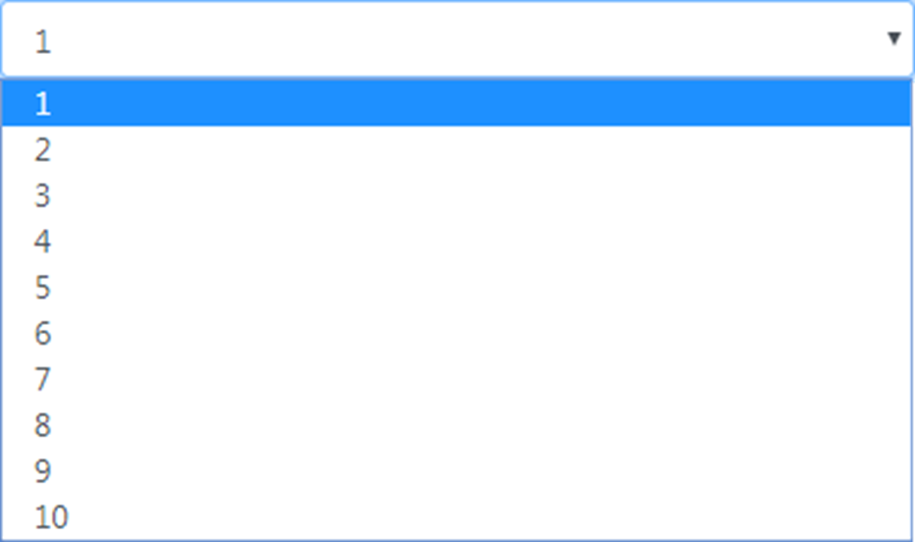
The <select> element displayed in a browser

Slide 30
One property of the TagHelperContext class
AllAttributes
Three properties of the ModelExpression class
Name
Model
Metadata
The using statement for the ViewFeatures namespace
using Microsoft.AspNetCore.Mvc.ViewFeatures;
// for ModelExpression

Slide 31
The updated NumberDropDownTagHelper class
[HtmlTargetElement("select", Attributes = "my-min-number, my-max-number")]
public class NumberDropDownTagHelper : TagHelper
{
// Min and Max properties same as before
public override void Process(TagHelperContext context,
TagHelperOutput output)
{
// get selected value from view's model
ModelExpression aspfor =
(ModelExpression) context.AllAttributes["asp-for"].Value;
int modelValue = (int)aspfor?.Model;
for (int i = Min; i <= Max; i++)
{
TagBuilder option = new TagBuilder("option");
option.InnerHtml.Append(i.ToString());
// mark option as selected if matches model's value
if (modelValue == i)
option.Attributes["selected"] = "selected";
output.Content.AppendHtml(option);
}
}
}

Slide 32
A tag helper that gets a ViewContext value via dependency injection (part 1)
using Microsoft.AspNetCore.Mvc.ViewFeatures;
using Microsoft.AspNetCore.Mvc.Rendering;
...
[HtmlTargetElement("a", Attributes = "[class=nav-link]",
ParentTag = "li")]
public class ActiveNavbarTagHelper : TagHelper
{
[ViewContext]
[HtmlAttributeNotBound]
public ViewContext ViewCtx { get; set; }
public override void Process(TagHelperContext context,
TagHelperOutput output)
{
string area =
ViewCtx.RouteData.Values["area"]?.ToString() ?? "";
string ctlr =
ViewCtx.RouteData.Values["controller"].ToString();

Slide 33
A tag helper that gets a ViewContext value via dependency injection (part 2)
string aspArea = context.AllAttributes["asp-area"]?.Value?
.ToString() ?? "";
string aspCtlr =
context.AllAttributes["asp-controller"].Value
.ToString();
if (area == aspArea && ctlr == aspCtlr)
output.Attributes.AppendCssClass("active");
}
}

Slide 34
A tag helper that gets a Cart object via dependency injection
[HtmlTargetElement("span", Attributes = "my-cart-badge")]
public class CartBadgeTagHelper : TagHelper
{
private ICart cart;
public CartBadgeTagHelper(ICart c) => cart = c;
public bool MyCartBadge { get; set; }
public override void Process(TagHelperContext context,
TagHelperOutput output)
{
output.Content.SetContent(cart.Count?.ToString());
}
}
The tag helper in a layout
<span class="fas fa-shopping-cart"></span>&nbsp;Cart
<span class="badge badge-light" my-cart-badge></span>

Slide 35
A layout that only displays an element if there’s a value in TempData
<main>
@if (TempData.Keys.Contains("message"))
{
<h4 class="bg-info text-center text-white p-2">
@TempData["message"]
</h4>
}
@RenderBody()
</main>

Slide 36
A method of the TagHelperOutput class
SuppressOutput()

Slide 37
A tag helper that only outputs HTML if there’s a value in TempData
using Microsoft.AspNetCore.Mvc.ViewFeatures;
using Microsoft.AspNetCore.Mvc.Rendering;
...
[HtmlTargetElement("my-temp-message")]
public class TempMessageTagHelper : TagHelper
{
[ViewContext]
[HtmlAttributeNotBound]
public ViewContext ViewCtx { get; set; }
public override void Process(TagHelperContext context,
TagHelperOutput output)
{
var td = ViewCtx.TempData;
if (td.Keys.Contains("message"))
{
output.BuildTag("h4", "bg-info text-center text-white p-2");
output.Content.SetContent(td["message"].ToString());
}
else
{
output.SuppressOutput();
}
}
}

Slide 38
A layout that uses the conditional tag helper
<main>
<my-temp-message />
@RenderBody()
</main>

Slide 39
A tag helper that generates a paging link (part 1)
using Microsoft.AspNetCore.Mvc.ViewFeatures;
using Microsoft.AspNetCore.Mvc.Rendering;
using Microsoft.AspNetCore.Routing;
using Bookstore.Models;
...
[HtmlTargetElement("my-paging-link")]
public class PagingLinkTagHelper : TagHelper
{
private LinkGenerator linkBuilder;
public PagingLinkTagHelper(LinkGenerator lg) => linkBuilder = lg;
[ViewContext]
[HtmlAttributeNotBound]
public ViewContext ViewCtx { get; set; }
public int Number { get; set; }
public RouteDictionary Current { get; set; }
public override void Process(TagHelperContext context,
TagHelperOutput output) {
// update routes for this paging link
var routes = Current.Clone();
routes.PageNumber = Number;

Slide 40
A tag helper that generates a paging link (part 2)
// get controller and action method, create paging link URL
string ctlr =
ViewCtx.RouteData.Values["controller"].ToString();
string action =
ViewCtx.RouteData.Values["action"].ToString();
string url =
linkBuilder.GetPathByAction(action, ctlr, routes);
// build up CSS string
string linkClasses = "btn btn-outline-primary";
if (Number == Current.PageNumber)
linkClasses += " active";
// create link
output.BuildLink(url, linkClasses);
output.Content.SetContent(Number.ToString());
}
}

Slide 41
A view that uses the PagingLink tag helper
@{
for (int i = 1; i <= Model.TotalPages; i++)
{
<my-paging-link number="@i"
current="@Model.CurrentRoute" />
}
}

Slide 42
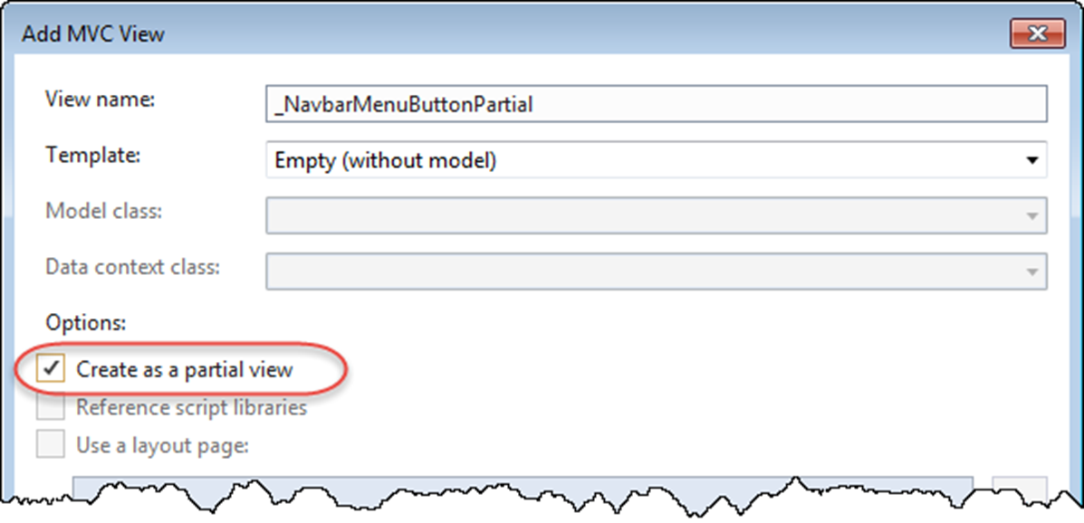
The Add MVC View dialog

Slide 43
The paths that MVC searches for a partial view
/Views/ControllerName/PartialViewName
/Views/Shared/PartialViewName

Slide 44
A partial view that loads the jQuery validation libraries
<script
src="~/lib/jquery-validation/dist/jquery.validate.min.js">
</script>
<script
src="~/lib/jquery-validation-unobtrusive/
jquery.validate.unobtrusive.min.js">
</script>
A tag helper that includes the partial view in a view
<partial name="_ValidationScriptsPartial" />

Slide 45
A partial view that contains the HTML for a Bootstrap navbar menu button
<button class="navbar-toggler" type="button" data-toggle="collapse"
data-target="#menu" aria-controls="menu"
aria-expanded="false"
aria-label="Toggle navigation">
<span class="navbar-toggler-icon"></span>
</button>
A layout that uses the partial view in a Bootstrap navbar
<nav class="navbar navbar-expand-md navbar-dark bg-dark">
<partial name="_NavbarMenuButtonPartial" />
<div class="collapse navbar-collapse" id="menu">
<ul class="navbar-nav mr-auto">...</ul>
</div>
</nav>

Slide 46
Four attributes of the partial tag helper
name
model
for
viewData

Slide 47
The _BookLinkPartial partial view
@model Book
<a asp-action="Details" asp-controller="Book"
asp-route-id="@Model.BookId"
asp-route-slug="@Model.Title.Slug()">
@Model.Title
</a>

Slide 48
The partial view in a view with the same model object (Home/Index)
@model Book
...
<h5>
<partial name="_BookLinkPartial" />
</h5>
...

Slide 49
The partial view in a view with a different model object (Book/List)
@model BookListViewModel
...
@foreach (Book book in Model.Items) {
<tr>
<td>
<partial name="_BookLinkPartial" model="@book" />
</td>
...

Slide 50
A method in a ViewComponent class
Invoke([params])
The folder for the view component classes
/Components

Slide 51
A view component that passes the Cart count to a partial view
using Microsoft.AspNetCore.Mvc;
...
public class CartBadge : ViewComponent
{
private ICart cart { get; set; }
public CartBadge(ICart c) => cart = c;
public IViewComponentResult Invoke() =>
View(cart.Count);
}
The Default.cshtml partial view
@model int?
<span class="badge badge-light">@Model</span>

Slide 52
The paths that MVC searches for a view component’s partial view
/Views/ControllerName/Components/ViewComponentName/ViewName
/Views/Shared/Components/ViewComponentName/ViewName

Slide 53
A layout that uses tag helper syntax to call the view component
<span class="fas fa-shopping-cart"></span>&nbsp;Cart
<vc:cart-badge></vc:cart-badge>

Slide 54
The DropDownViewModel class
public class DropDownViewModel
{
public Dictionary<string, string> Items { get; set; }
public string SelectedValue { get; set; }
public string DefaultValue { get; set; }
}

Slide 55
A view component with an Invoke() method that has a parameter
public class AuthorDropDown : ViewComponent
{
private IRepository<Author> data { get; set; }
public AuthorDropDown(IRepository<Author> rep) => data = rep;
public IViewComponentResult Invoke(string selectedValue)
{
var authors = data.List(new QueryOptions<Author> {
OrderBy = a => a.FirstName
});
var vm = new DropDownViewModel {
SelectedValue = selectedValue,
DefaultValue = "All",
Items = authors.ToDictionary(
a => a.AuthorId.ToString(), a => a.FullName)
};
return View(
"~/Views/Shared/Components/Common/DropDown.cshtml", vm);
}
}

Slide 56
The DropDown partial view
@model DropDownViewModel
<select name="filter" class="form-control m-2"
asp-items="@(new SelectList(
Model.Items, "Key", "Value", Model.SelectedValue))">
<option value="@Model.DefaultValue">All</option>
</select>

Slide 57
A view that uses the view component
<label>Author: </label>
<vc:author-drop-down
selected-value="@Model.CurrentRoute.AuthorFilter">
</vc:author-drop-down>

Slide 58
The generic GridViewModel class
public class GridViewModel<T>
{
public IEnumerable<T> Items { get; set; }
public RouteDictionary CurrentRoute { get; set; }
public int TotalPages { get; set; }
}

Slide 59
The List() action method of the Book controller
public ViewResult List(BooksGridDTO values)
{
/* code that creates GridBuilder and QueryOptions objects to
retrieve a list of paged, sorted, and filtered books */
var vm = new GridViewModel<Book> {
Items = data.List(options),
CurrentRoute = builder.CurrentRoute,
TotalPages = builder.GetTotalPages(data.Count)
};
return View(vm);
}

Slide 60
The List() action method of the Author controller
public ViewResult List(GridDTO vals)
{
/* code that creates GridBuilder and QueryOptions objects to
retrieve a list of paged and sorted authors */
var vm = new GridViewModel<Author> {
Items = data.List(options),
CurrentRoute = builder.CurrentRoute,
TotalPages = builder.GetTotalPages(data.Count)
};
return View(vm);
}

Slide 61
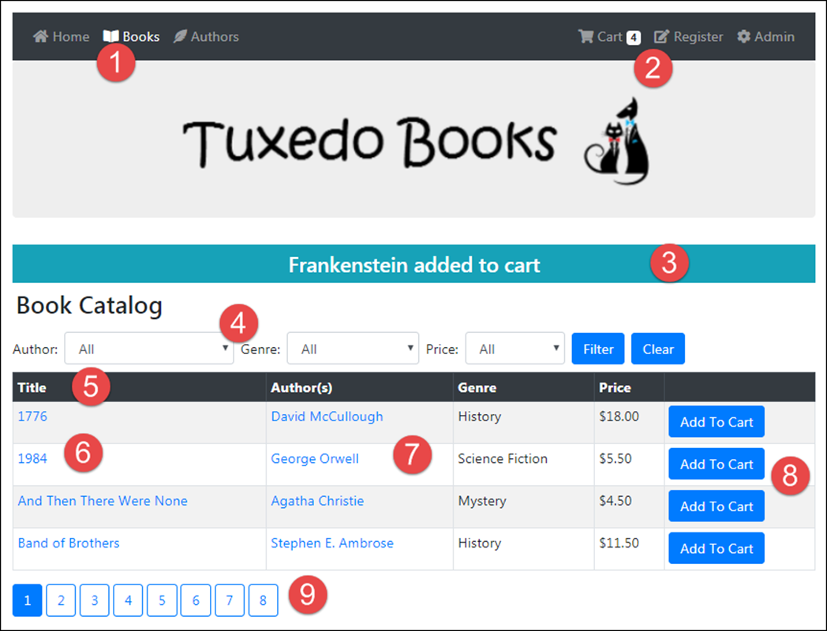
The Book Catalog page

Slide 62
The custom tag helpers, partial views, and view components in this page
The ActiveNavbar tag helper.
The CartBadge view component.
The TempMessage tag helper.
The AuthorDropDown view component. The other drop-down lists are view components that work similarly.
The SortingLink tag helper.
The _BookLink partial view.
The _AuthorLink partial view.
The Button tag helper.
The paging-links partial view, containing the paging-link tag helper.

Slide 63
The updated ActiveNavbar tag helper that accounts for the Admin area (part 1)
[HtmlTargetElement("a", Attributes = "[class=nav-link]",
ParentTag = "li")]
public class ActiveNavbarTagHelper : TagHelper
{
[ViewContext]
[HtmlAttributeNotBound]
public ViewContext ViewCtx { get; set; }
[HtmlAttributeName("my-mark-area-active")]
public bool IsAreaOnly { get; set; }
public override void Process(TagHelperContext context,
TagHelperOutput output)
{
string area = ViewCtx.RouteData.Values["area"]?
.ToString() ?? "";
string ctlr = ViewCtx.RouteData.Values["controller"]
.ToString();

Slide 64
The updated ActiveNavbar tag helper (part 2)
string aspArea = context.AllAttributes["asp-area"]?.Value?
.ToString() ?? "";
string aspCtlr = context.AllAttributes["asp-controller"]
.Value.ToString();
if (area == aspArea && ctlr == aspCtlr)
output.Attributes.AppendCssClass("active");
else if (IsAreaOnly && area == aspArea)
output.Attributes.AppendCssClass("active");
}
}

Slide 65
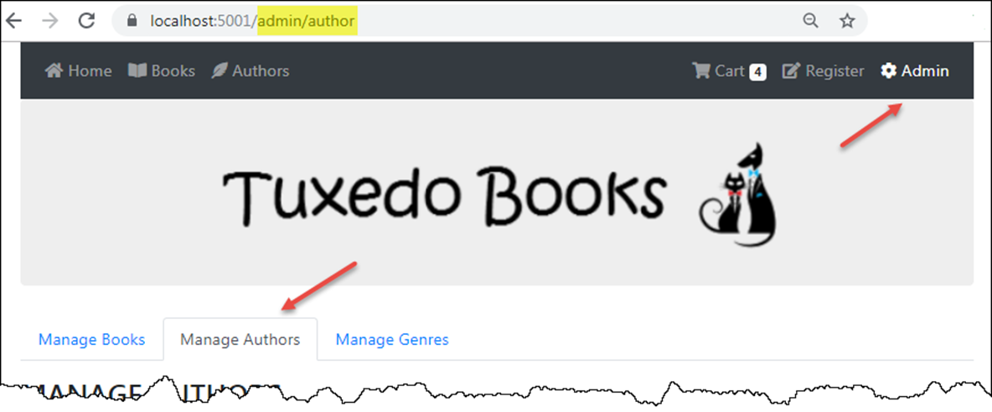
The two active navbar links on the Manage Authors page of the Admin area

Slide 66
The layout of the Bookstore app (part 1)
<!DOCTYPE html>
<html lang="en">
<head>...</head>
<body>
<div class="container">
<nav class="navbar navbar-expand-md navbar-dark bg-dark">
<partial name="_NavbarMenuButtonPartial" />
<div class="collapse navbar-collapse" id="menu">
<ul class="navbar-nav mr-auto">
<li class="nav-item">
<a class="nav-link" asp-action="Index"
asp-controller="Home" asp-area="">
<span class="fas fa-home"></span>
&nbsp;Home
</a>
</li>
@* nav item links for Books and Authors *@
</ul>

Slide 67
The layout of the Bookstore app (part 2)
<ul class="navbar-nav ml-auto">
<li class="nav-item">
<a class="nav-link" asp-action="Index"
asp-controller="Cart" asp-area="">
<span class="fas fa-shopping-cart">
</span>&nbsp;Cart
<vc:cart-badge></vc:cart-badge>
</a>
</li>
@* nav item link for Registration goes here *@
<li class="nav-item">
<a class="nav-link" asp-action="Index"
asp-controller="Book" asp-area="Admin"
my-mark-area-active>
<span class="fas fa-cog"></span>
&nbsp;Admin
</a>
</li>
</ul>
</div>
</nav>

Slide 68
The layout of the Bookstore app (part 3)
<header class="jumbotron text-center">
<a asp-action="Index" asp-controller="Home">
<img src="~/images/logo.png"
class="img-fluid center-block" />
</a>
</header>
<main>
<my-temp-message />
@RenderBody()
</main>
</div>
<script src="~/lib/jquery/dist/jquery.min.js"></script>
<script src="~/lib/bootstrap/dist/js/bootstrap.bundle.min.js">
</script>
<script src="~/js/site.js" asp-append-version="true"></script>
@RenderSection("Scripts", required: false)
</body>
</html>

Slide 69
The Book/List view (part 1)
@model GridViewModel<Book>
...
<form asp-action="Filter" method="post" class="form-inline">
<label>Author: </label>
<vc:author-drop-down
selected-value="@Model.CurrentRoute.AuthorFilter">
</vc:author-drop-down>
<label>Genre: </label>
<vc:genre-drop-down
selected-value="@Model.CurrentRoute.GenreFilter">
</vc:genre-drop-down>
<label>Price: </label>
<vc:price-drop-down
selected-value="@Model.CurrentRoute.PriceFilter">
</vc:price-drop-down>
<button type="submit" class="mr-2">Filter</button>
<button type="submit" name="clear" value="true">Clear</button>
</form>

Slide 70
The Book/List view (part 2)
<form asp-action="Add" asp-controller="Cart" method="post">
<table class="table table-bordered table-striped table-sm">
<thead class="thead-dark">
<tr>
<th>
<my-sorting-link sort-field="Title"
current="@Model.CurrentRoute">Title
</my-sorting-link></th>
<th>Author(s)</th>
<th>
<my-sorting-link sort-field="Genre"
current="@Model.CurrentRoute">Genre
</my-sorting-link></th>
<th>
<my-sorting-link sort-field="Price"
current="@Model.CurrentRoute">Price
</my-sorting-link></th>
<th></th>
</tr>
</thead>

Slide 71
The Book/List view (part 3)
<tbody>
@foreach (Book book in Model.Items) {
<tr>
<td><partial name="_BookLinkPartial" model="@book" />
</td>
<td>
@foreach (var ba in book.BookAuthors) {
<p><partial name="_AuthorLinkPartial"
model="@ba.Author" /></p>
}
</td>
<td>@book.Genre?.Name</td>
<td>@book.Price.ToString("c")</td>
<td><button type="submit" name="id"
value="@book.BookId">Add To Cart
</button>
</td>
</tr>
}
</tbody>
</table>
</form>
<partial name="_PagingLinksPartial" />

